Slide 1


My country
THAT´S IT
Kristián Dadej VI.A.

Slide 2
THAT´S IT
THAT´S IT is a beautiful country
there are a lot of green parks, bushes and trees
the capital city is Screwups
in this city are people who are extremely unpractical, left-handed, screwup, but very lucky
the symbols of this city are Pat and Mat
all people in this country speak babble language
there live exactly 666,000 people

Slide 3
THAT´S IT
RULES:
All people must be left-handed and screwup
Their work must be really bad
All must wear red or yellow pullovers, jackets, jumpers or shirts
All must wear caps
All must be bald-headed

Slide 4
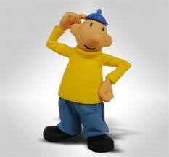
THAT´S IT
The president of my country is Mr. Ing. MUDr. PUDr. Jozo Pat
Our anthem is : https://youtu.be/Wa_arqDWG3o - pat a mat hardcore remix

Slide 5
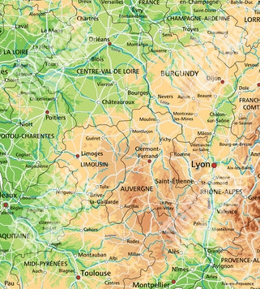

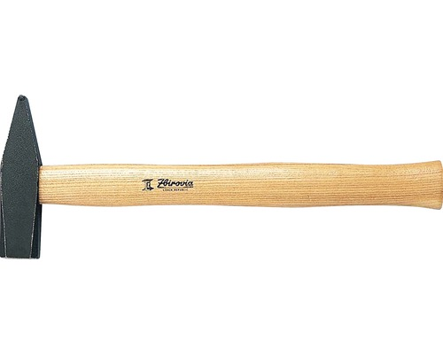
THAT´S IT
The map of my country is: The flag:
The reason of circle map is that people can walk constantly and they never get lost
The hammer is typical tool of citizens. The colors red and yellow are typical for clothes.

Slide 6
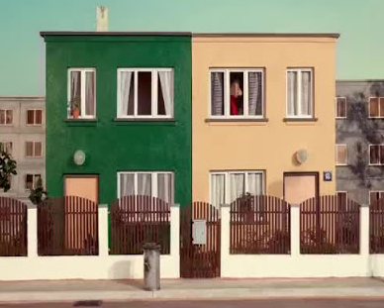
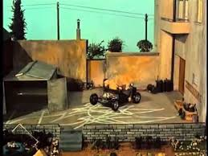
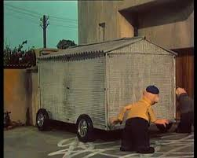
THAT´S IT
the landmarks of my country are:
„Trash can“ monument – the houses where famous Pat&Mat live
„Car temple“ – the famous garage with painted lines for successful parking

Slide 7
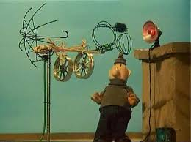
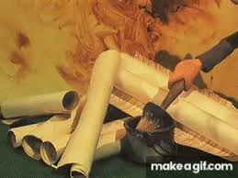
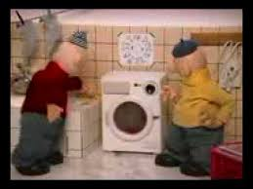
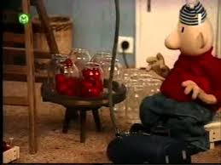
THAT´S IT
the landmarks of my country are:
The antenna – a „technical“ masterpiece
Memorable wall paper hanging
Famous strawberry washing machine
Filling carousel – famous handicraft

Slide 8
THAT´S IT
resources:
www.google.com/pictures
www.youtube.com/music
TV movies

