Slide 1
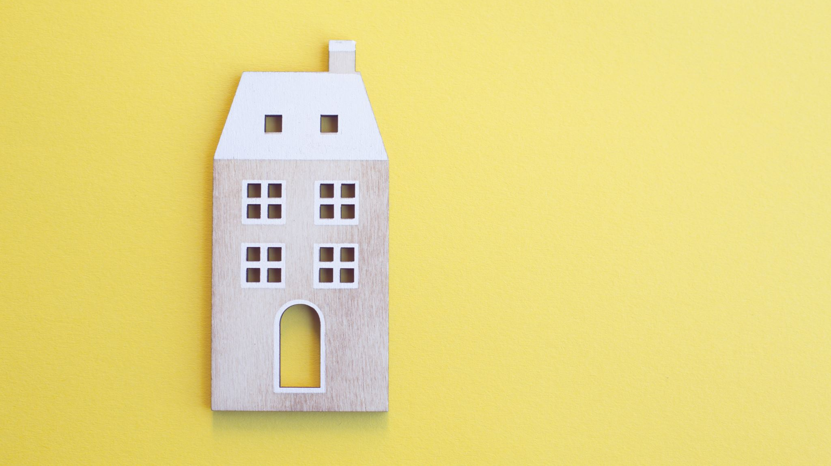
WIZARDLOR
Alexandra Farkašová 6.a

Slide 2
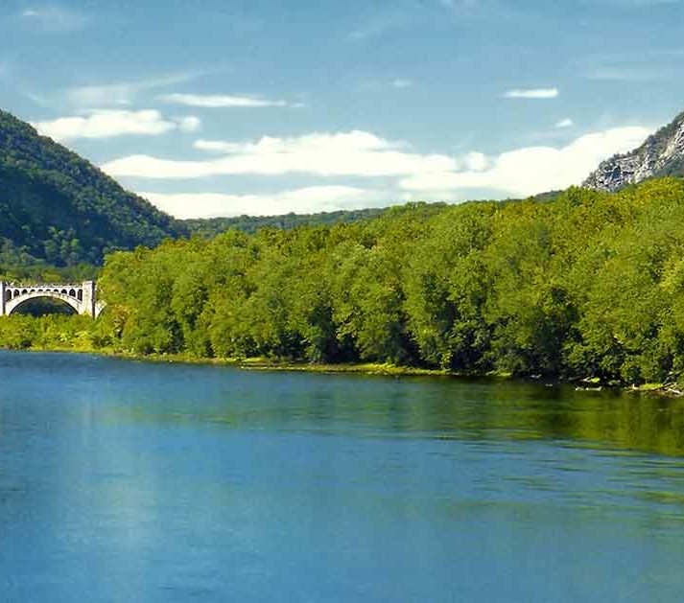
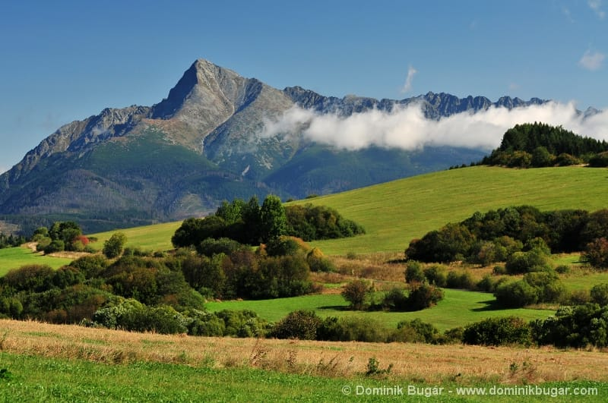
Geography of Wizardlor
This country is small. It is a bit smaller than Slovakia.
There are two long rivers. The longer is Butterver and second one is Clover river.
Mountains aren‘t very high. The highest mountain is Gryffindor mountian. It is 1853 meters high.

Slide 3

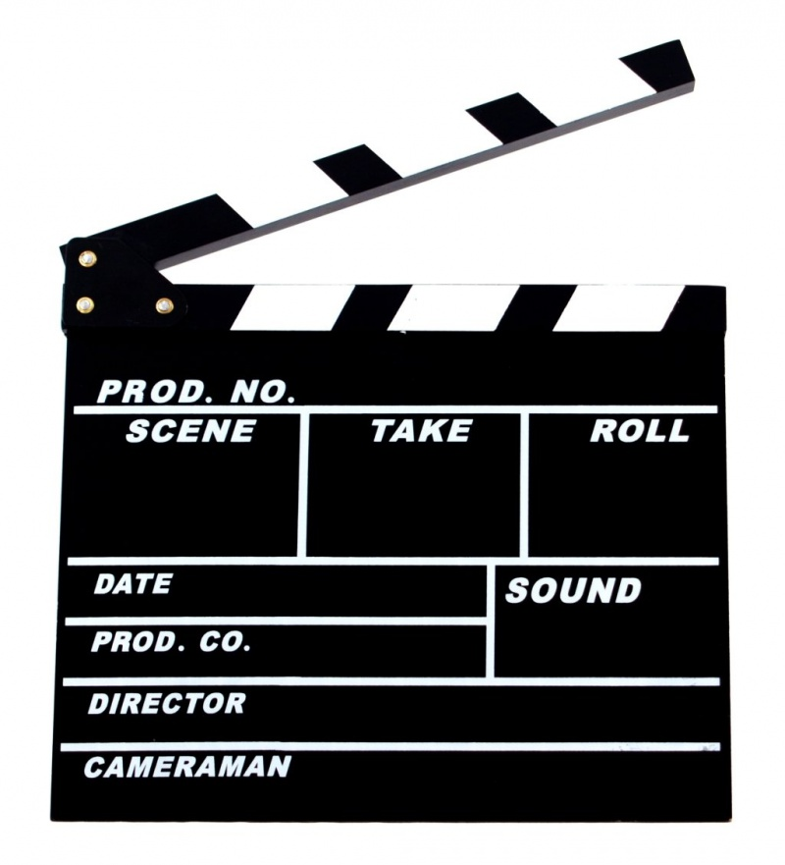

Production
Wizardlor produces:
Books
Food
Music
TV programes and movies

Slide 4
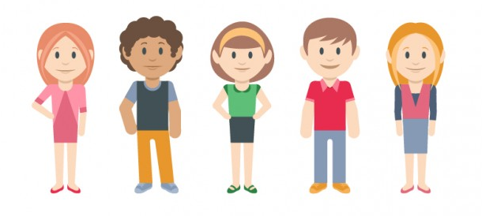
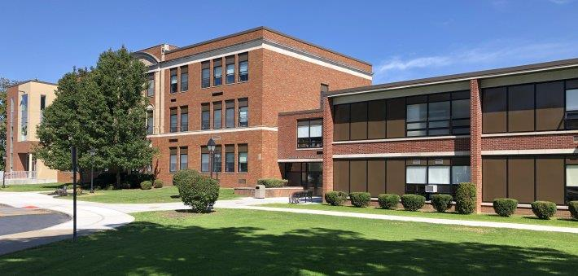

Population
Wizardlor has population of about 4,5 million people.
Most of the people live in cities, but some people live in villages too.
The biggest city and the capital is Hog city. About 500 thousands people live there.
The second biggest city is Huffle city and the third is Rowen city.
All children from 6 to 18 must go to school.
There are no people without work in Wizardlor.
In Wizardlor people speak: English, French and Slovak.

Slide 5
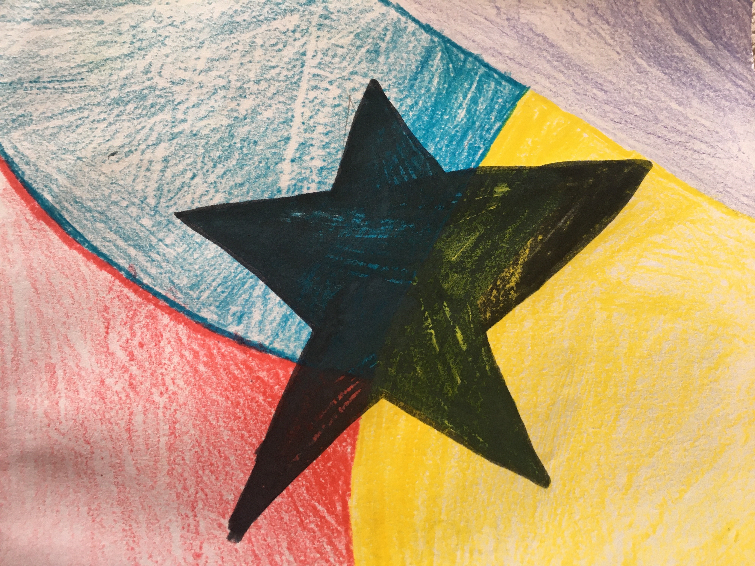
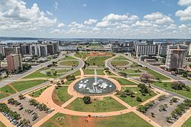
President and flag
The name of the president of Wizardlor is Alexandra Farkašová.
She lives in the capital in the President castle.
Our flag is violet, yellow, blue and red with big black star in the middle.
Each colour represenets one of four tribes, which live in Wizardlor.(Vilolet – Pureblood, yellow – Halfblood, red – muggels, blue – Hogles)
Black star represents magic.

Slide 6
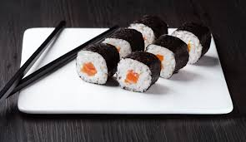
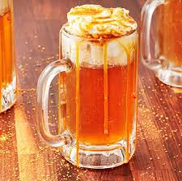
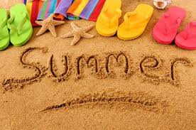
Traditions
Our traditional food is Sushi. Traditional drink is Butter beer.
Every summer at the beginning of the holidays, children throughout the country have the Farewell school party, when Butter beer and Sushi are served completely for free.

Slide 7
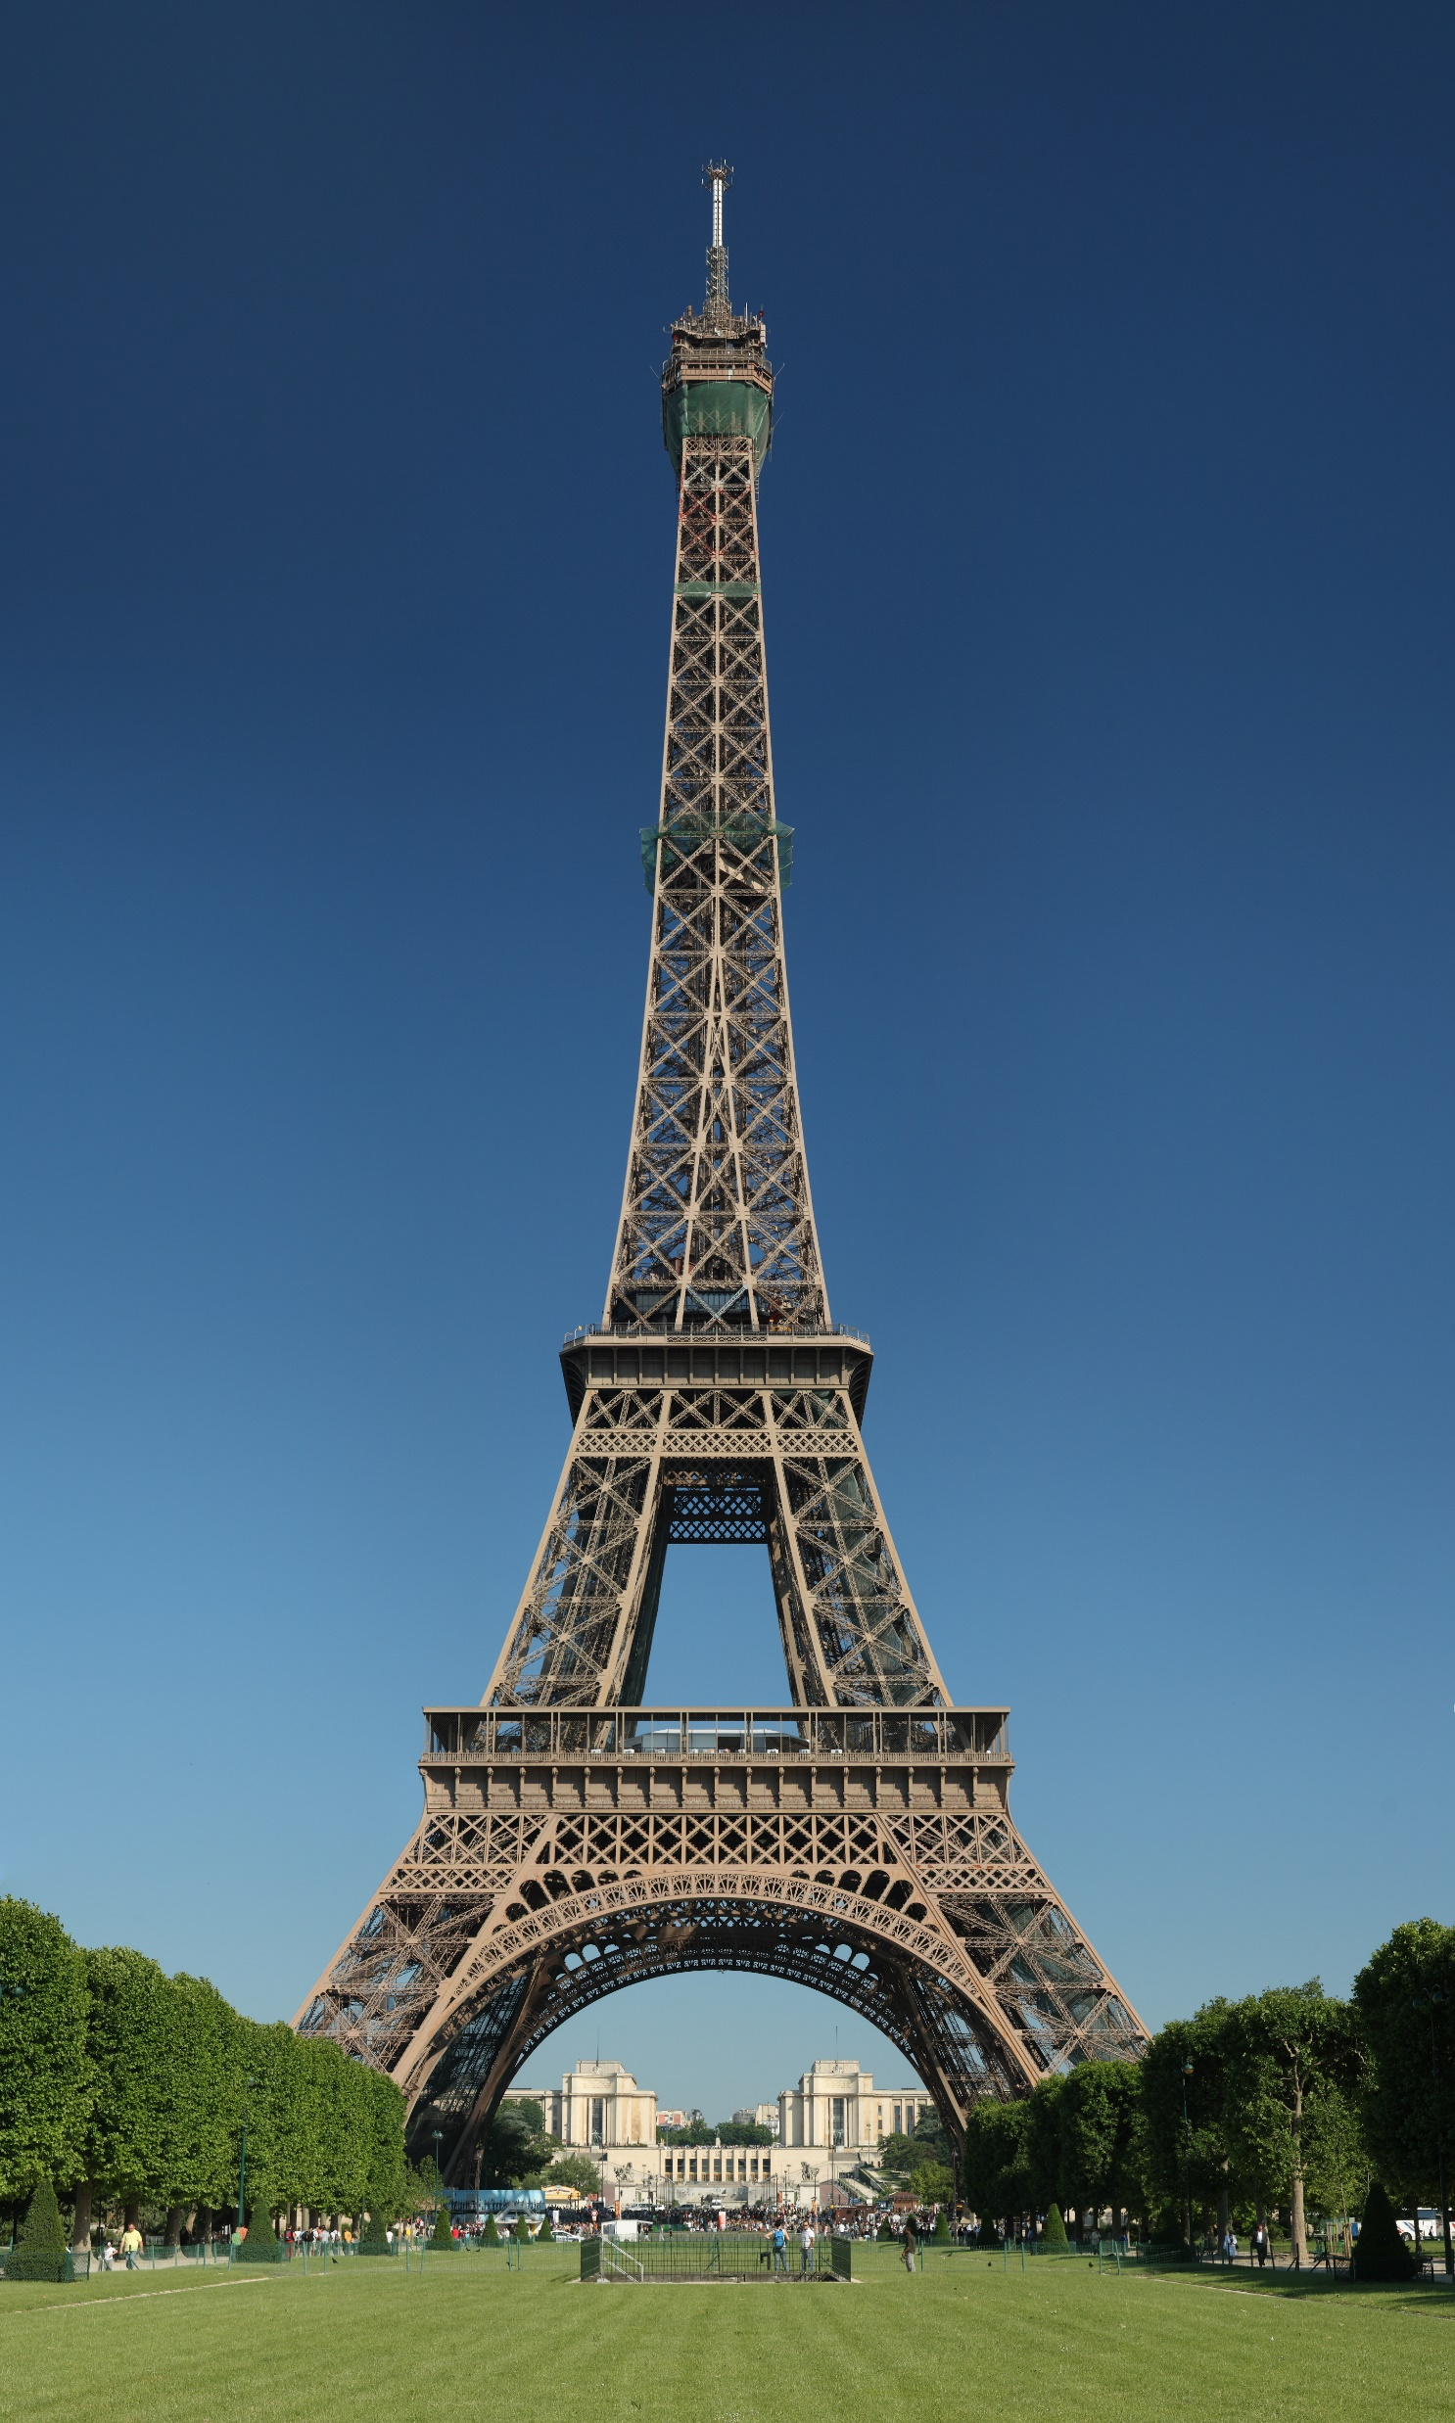
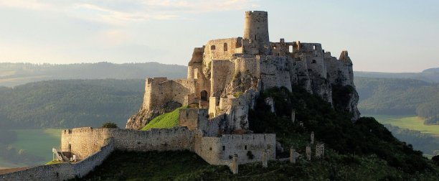
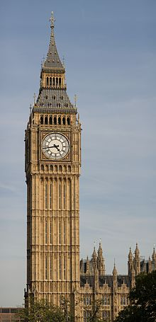
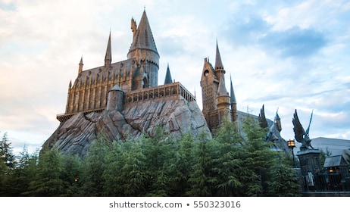
Monuments
We‘ve got 4 big monuments:
Eiffel tower
Ruin of Spišský castle
Big Ben
Hogwarts school - is the oldest school in our country

Slide 8
Resources: - www.google.com
Thank you for your attention and for your time.☺☺☺

