Slide 1
Kapako
Kornel kľoc VI.A

Slide 2

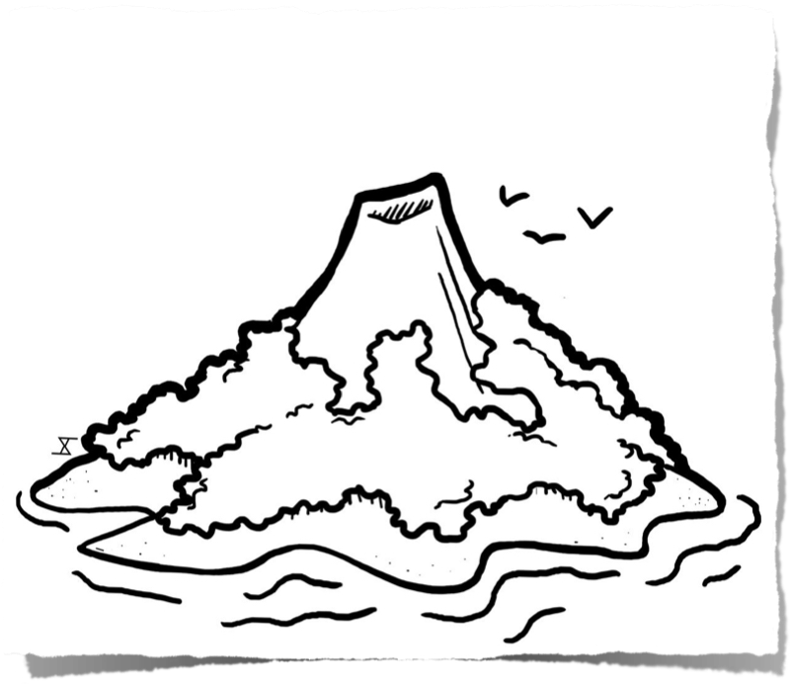
Location and about Kapako.
Kapako is an island near equator. It is one of undiscovered islands near Madagascar. Most of the island is rainforests, and a minority of the beach and in the middle of the island is a large volcano. Kapako has an area of 200thousand hectars.

Slide 3
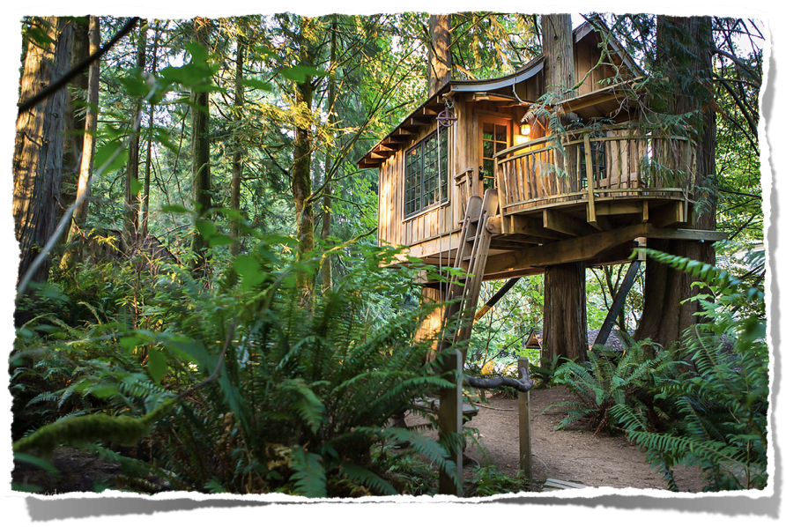
Houses and people
People in Kapako build tree-houses because there are many predators and insects on the ground. People are friendly to nature and animals and are vegetarians.

Slide 4
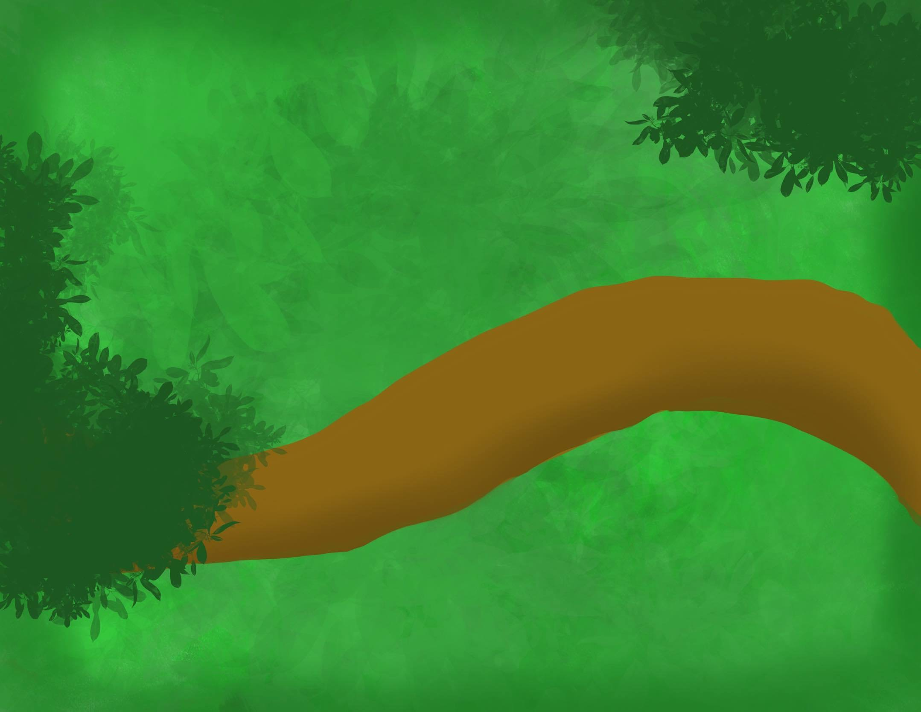
Flag
The green color on the flag symbolizes diverse nature, and the branch symbolizes the fruit's food source. (people in Kapako consider trees sacred)

Slide 5
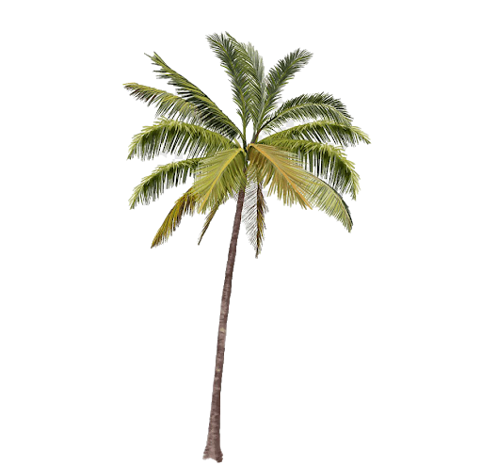
Food and drinks
The people in Kapako, as I said, are vegetarians, they eat the fruits of trees. And they are farmers. They do not drink alcohol they only drink water and fruit juice.

Slide 6
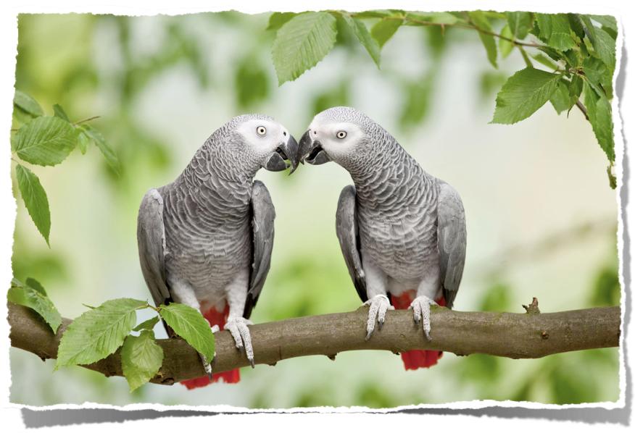
Nature and animals
Humans in Kapako live with animals and plants in symbiosis, they don't kill and destroy them. They use nutritive volcanic soil as a fertilizer.

Slide 7
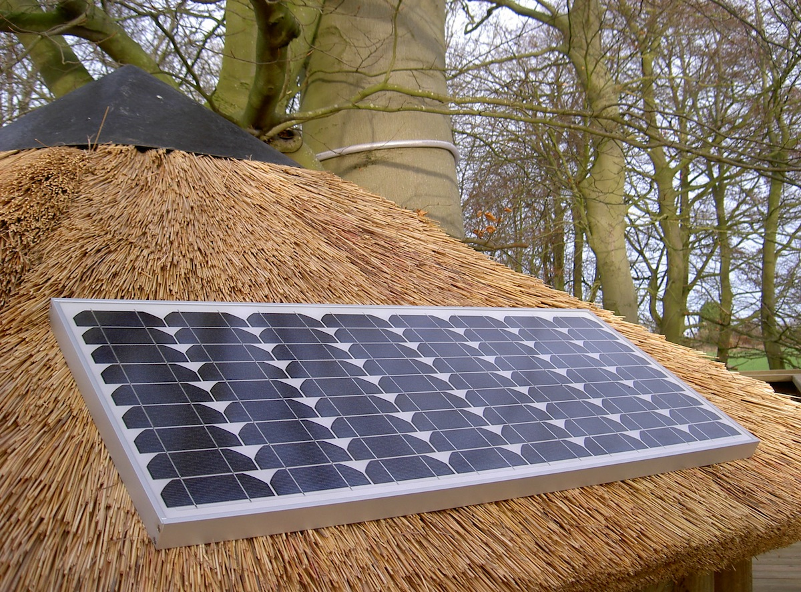
transport and energy
In kapako people move exclusively on foot but when it is necessary and carry heavy loads use electric cars. They generate electricity with the help of solar panels and when grilling or burning a fireplace instead of wood. Use cow excrements that do not smoke and are environmentally friendly and above all do not stink.

Slide 8
Thanks for paying attention
resources:
sk.pinterest.com
booking.com
pngall.com
nytimes.com
www.treehouselife.co.uk

