Slide 1
Galaria
Writen by Lukáš Calllo

Slide 2
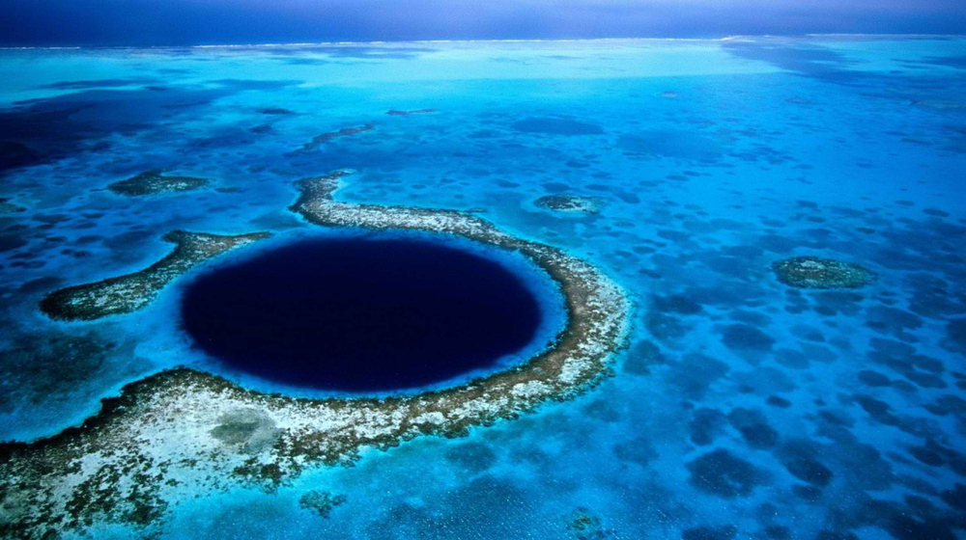
The Location of Galaria
Galaria is located underwater near the Mariana Trench. It has a giant bubble around it that makes breathing and living in Galaria easy. People in Galaria gather food from the ocean and surface.

Slide 3

The president of Galaria
The Galarian president is a bear. It has also got a representative which is me. The president is very inteligent and it was his idea to put
Galaria under water.

Slide 4
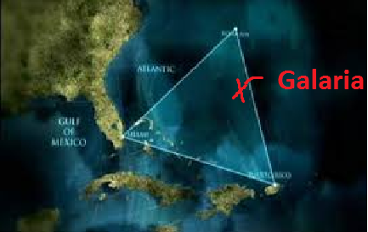
The map of Galaria
Galaria cant be seen on the map becouse it‘s under water near the Mariana Trench. You need a special map that shows where exactly Galaria is. It looks like this:

Slide 5

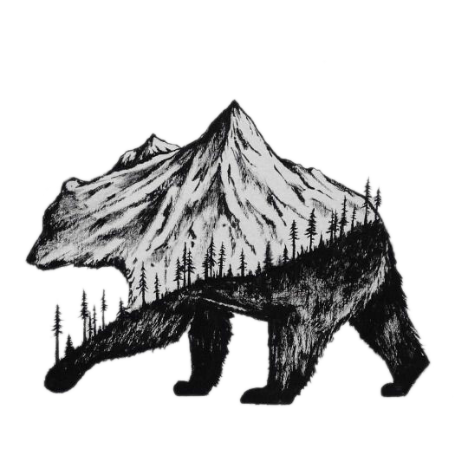
The flag of Galaria
The Galarian flag is VERY simple. Since the president is a bear, the flag looks very nice. This is the flag:

Slide 6
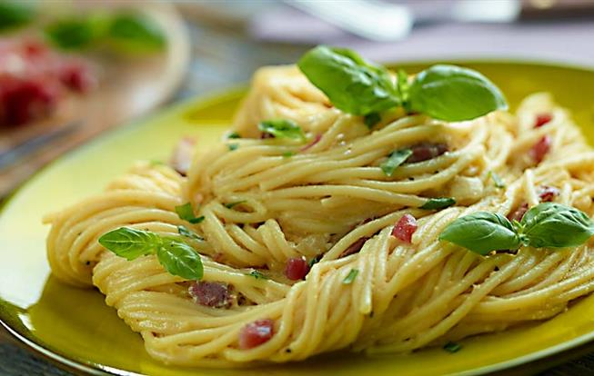
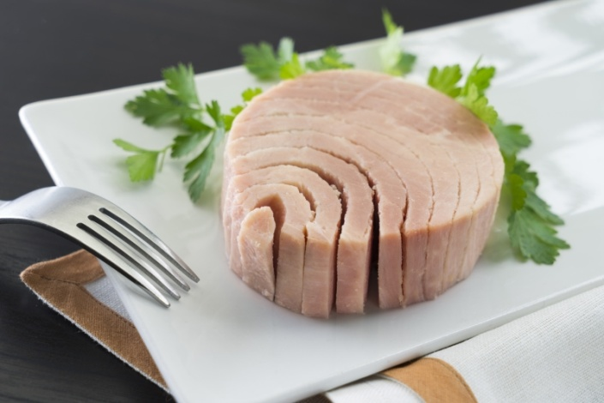
Foods of Galaria
Galaria has various food types. The biggest delicacys are fish. Like fried salmon, baked tuna or fish cake. But Galaria even has Bear spagetti and a delicasy called: Russian Bear attack. The Russian bear attack is spagetti with fish boiled in water with a shot of Vodka.

Slide 7
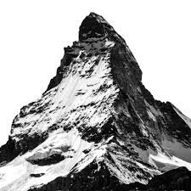
The monumets of Galaria
Galarias biggest monument is the statue of the founder of Galaria, Russian Bear. It also has other monumets like: Russian Bears house, books that Russain Bear wrote when he was young and Mount. Grizzley.

Slide 8
The rules of Galaria
Galaria is a free country, but there are some rules.
One: Criminals are not welcome in Galaria
Two: People should respect the rules and laws of Galaria
Three: Vodka is not alcohol, but a soft drink
Four: Follow these rules and you will be fine.

Slide 9
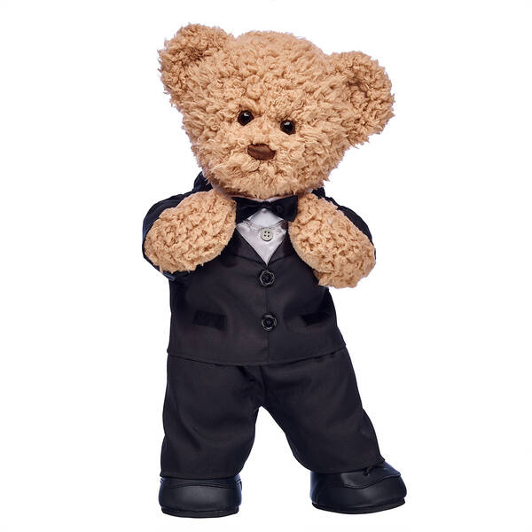
Thank you for reading/listening!

