Slide 1
United Mars Colonies
Martina Grodná

Slide 2
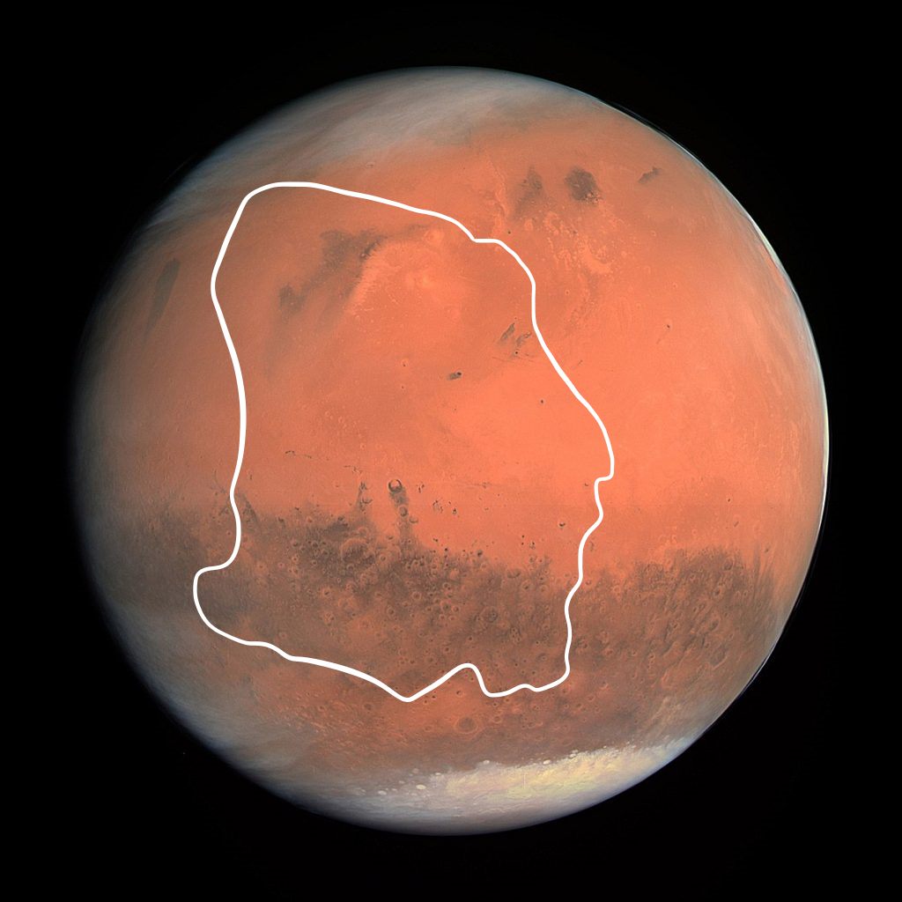
United Mars Colonies
United Mars Colonies also know as UMC, is the biggest country on Mars. There are 48 cities.
The area size is 18,2 mil. km². The population is
6,4 mil. citizens.

Slide 3
Flag
Blue on this flag stands for peace. Orange circle represents planet Mars and two small circles stands for two moons of Mars- Phobos and Deimos.

Slide 4
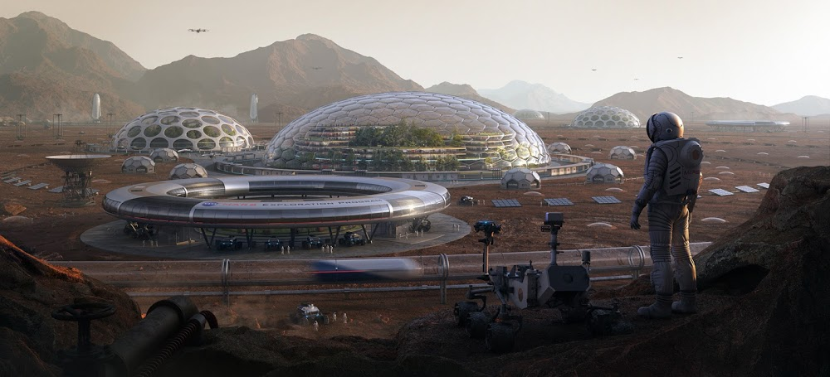
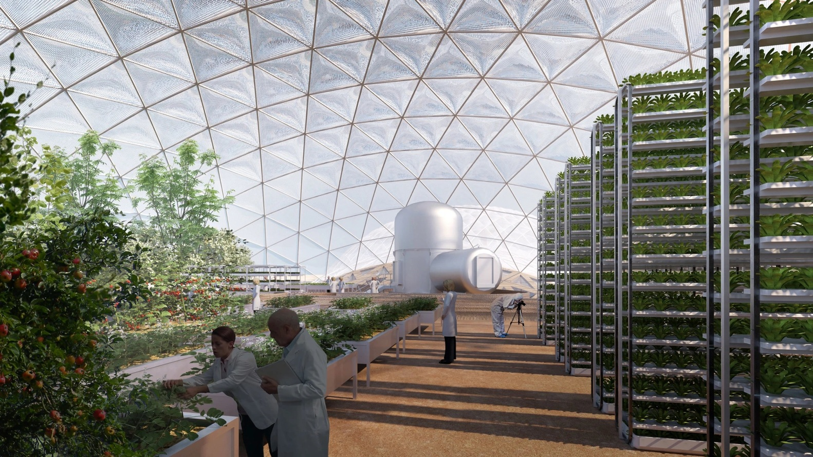
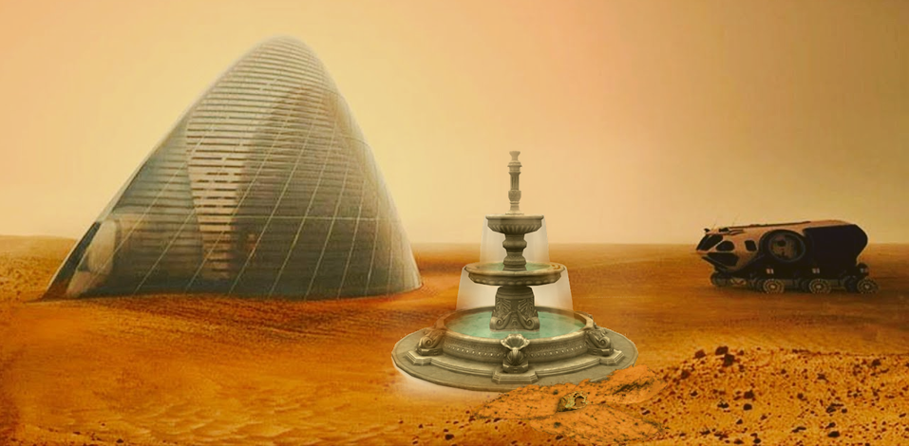
Mars City
This is capital city of UMC and it is very big. It has got 620 000 people. It has large greenhouses where people are growing vegetables and fruit in large. People are very happy to go to the shoping mall in the city center. In the outskirts of Mars City, there is the most beatifull fountaine in Mars City.

Slide 5
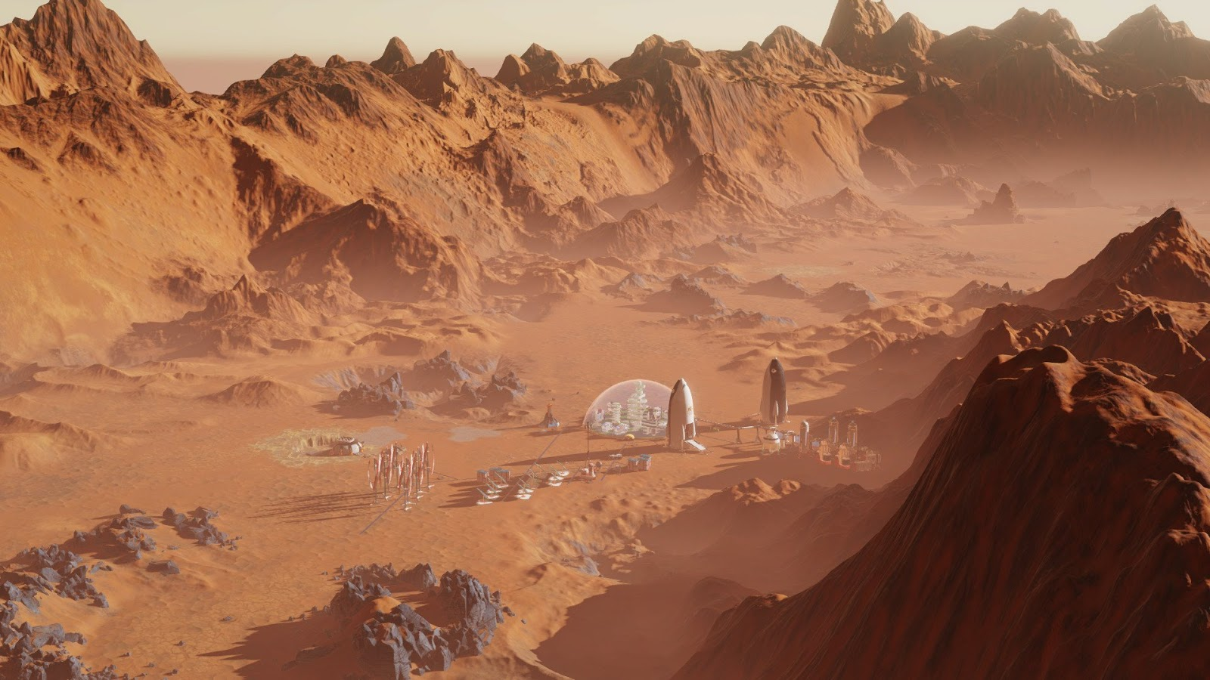
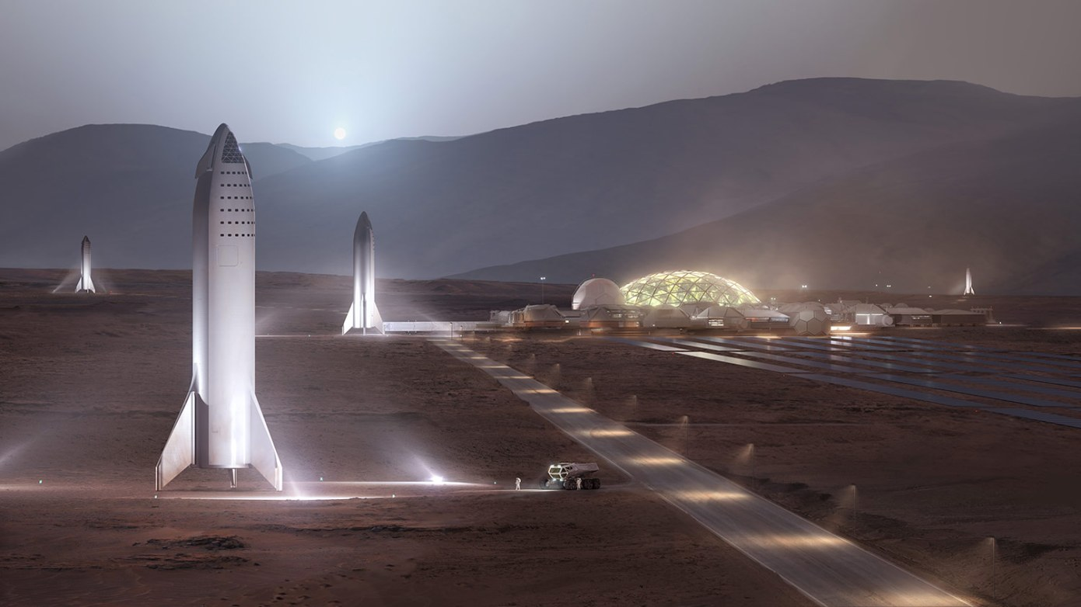
Sightseeings
Mars Canyon
A huge natural canyon close to Mars City. A very popular destination for tourists.
Space port
International Rocket Service, the travel between Earth, Moons, Mars and everywhere in solar system.
Phobos and Deimos
Mars moons with a good view of some parts of the planet. On moons there are excellent wellness spas.

Slide 6
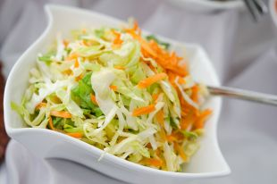
Food and drink
On Mars people have sacred food and that is carrot and cabbage salad with a special ingredient parsley. And a special drink is a base syrup with mint and lime. All this is grown in Mars greenhouses.

Slide 7
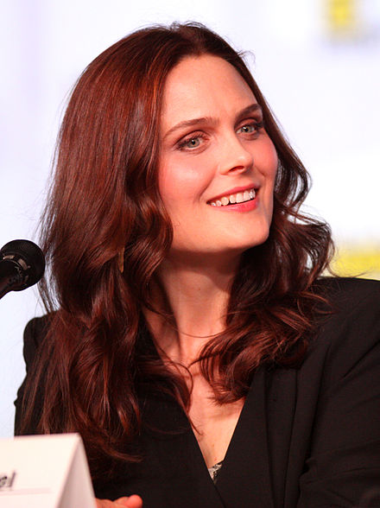
President
Emily Deschanel
She is current president of UMC, because citizens love the show Bones and she is the main character. Since she is the president of this country, there are no murders here, because she is very good at revealing them.

Slide 8
https://www.archdaily.com/927005/ted-talk-bjarke-ingels-explores-living-and-building-on-mars/5daf30b63312fd9f5d0000c1-ted-talk-bjarke-ingels-explores-living-and-building-on-mars-image
https://www.humanmars.net/2019/04/1-million-human-colony-city-on-mars-by.html
https://thedigitalwise.com/2019/12/07/life-in-mars-human-beings-can-now-thrive-in-red-planets-conditions/
https://techcrunch.com/wp-content/uploads/2019/11/mars-bfrs.jpg?w=1390&crop=1
https://www.humanmars.net/2018/02/human-colony-in-martian-canyon-from.html
https://www.skyatnightmagazine.com/space-science/the-moons-of-mars/
https://aif.ru/food/recipies/mamin_salat_iz_redki_kapusty_i_morkovi
https://sk.wikipedia.org/wiki/Emily_Deschanelov%C3%A1
Thank you for waching

