Slide 1
Studyland
Miriam Lisyová, 6.A

Slide 2
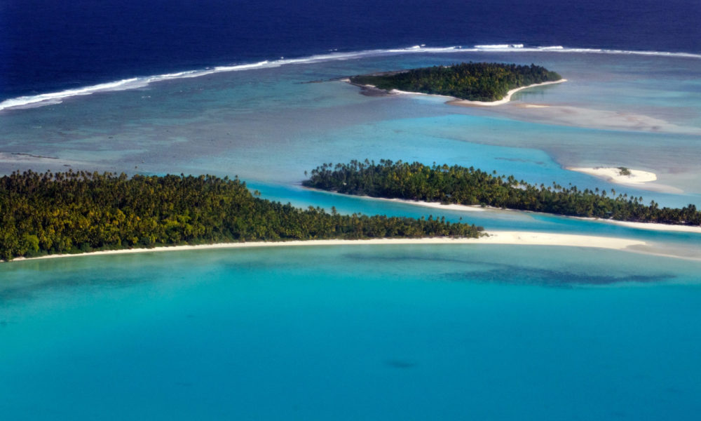
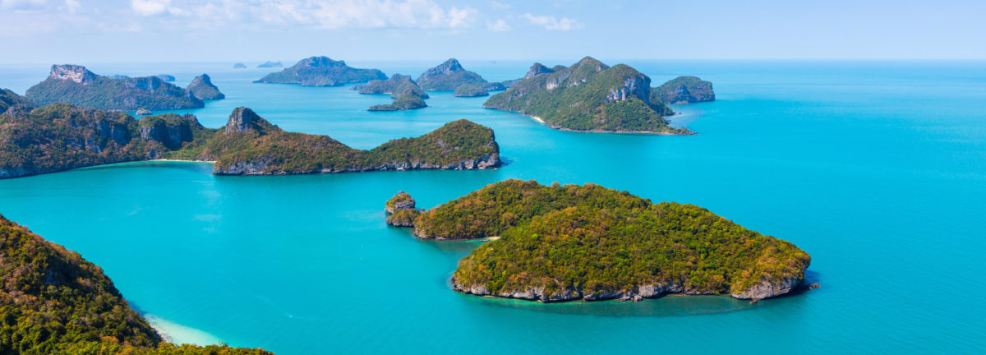
Studyland is not very much big country
It´s divided into five islands: the largest island in the western island named Folkland, the westwern island is much largest than the other islands and they are:
The nornhern island is named Winterland
The eastern has name Springland
The southern is named Summertimeland
And Meditenanean Island has name Autumnland
Notes:
Vložte mapu danej krajiny.

Slide 3
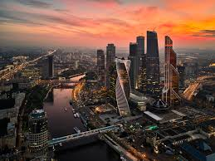
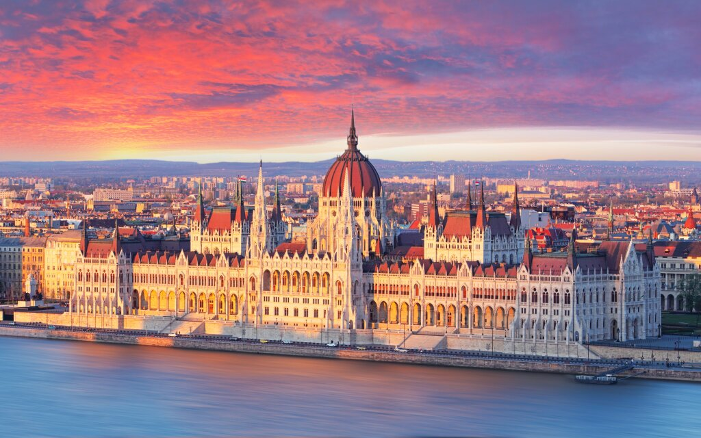
It´s divided into twelve states
The capital state is Folkstate, however, it´s the largest and the biggest state in Studyland
The second large state is Queenland
People think the biggest castle is in the capital city, but that´s not true!
Because the biggest castle in the world is in Queenland. It´s called Historyland.
Notes:
Vložte obrázok jedného geografického útvaru danej krajiny.

Slide 4
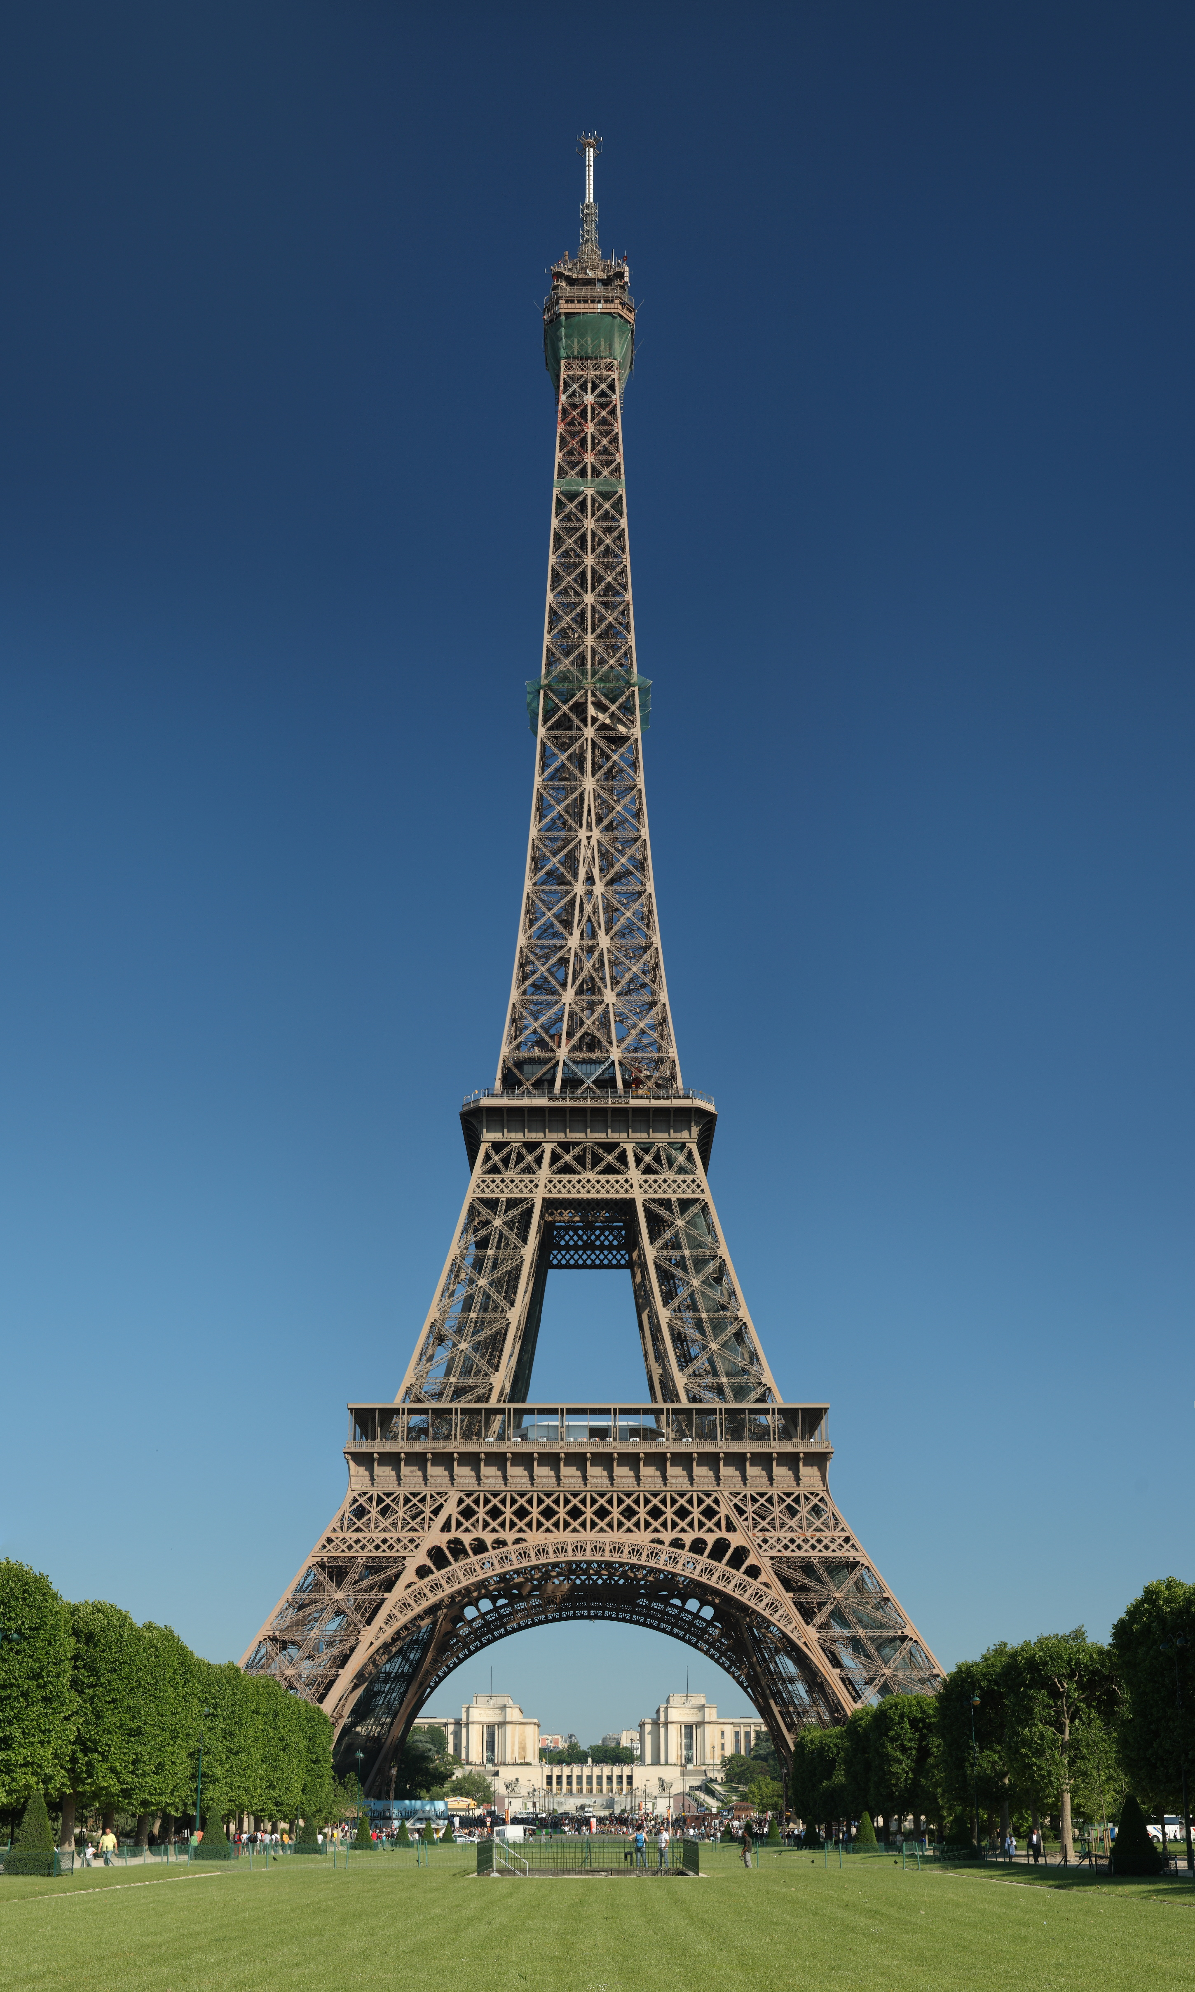
The symbol of
Studyland is:
Eiffel Tower
Why???
Because people like the Eiffel Tower very much
Notes:
Vložte obrázok znázorňujúci ročné obdobie v danej krajine.

Slide 5
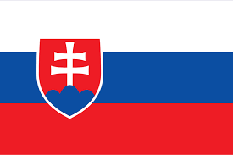
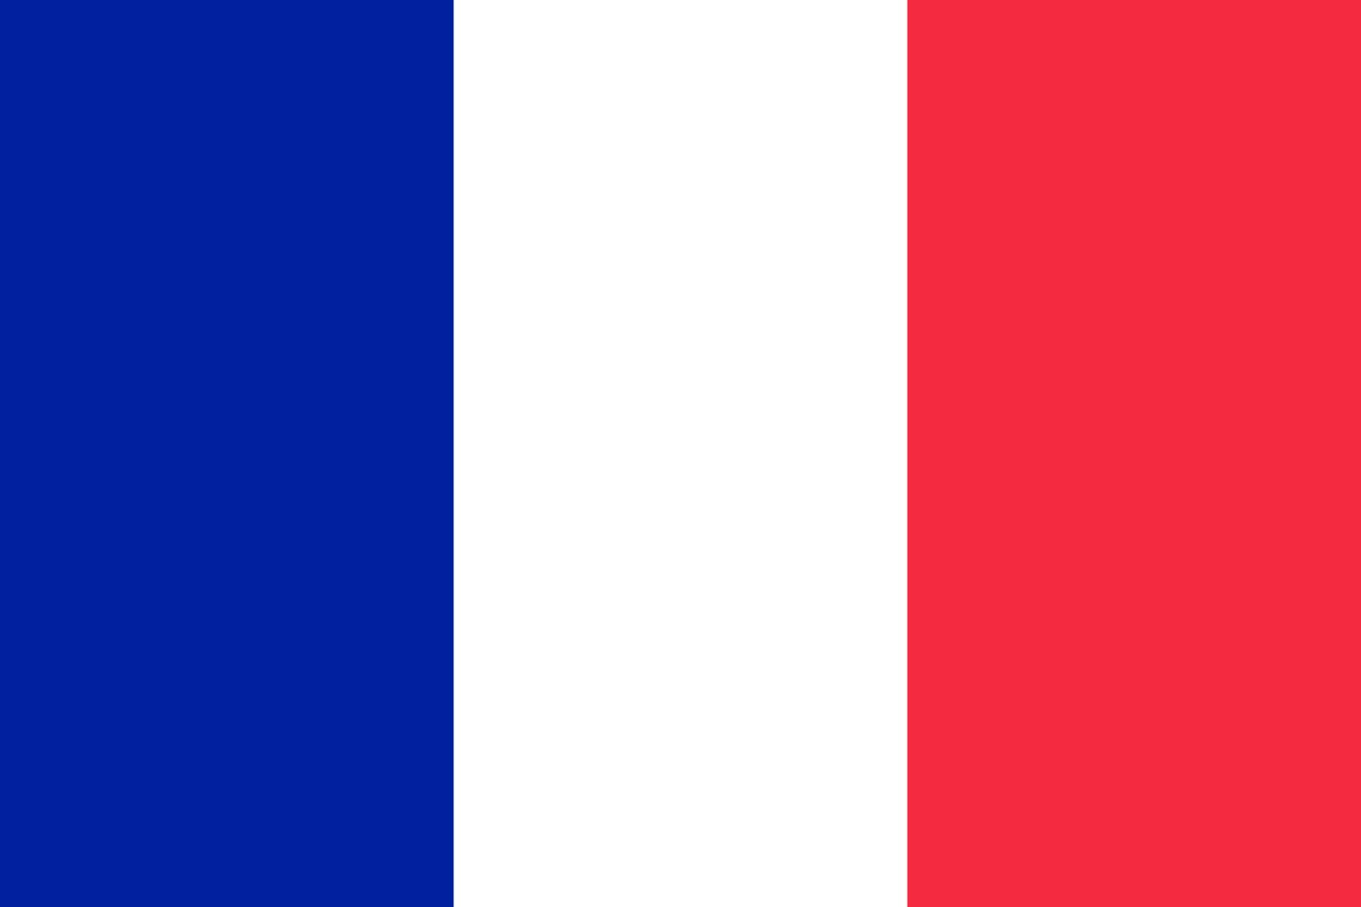
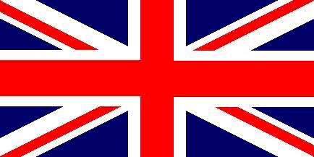
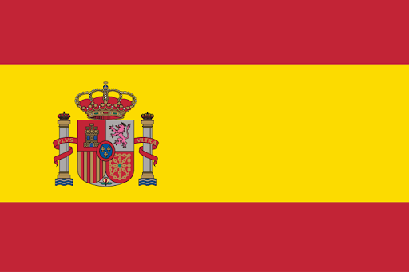
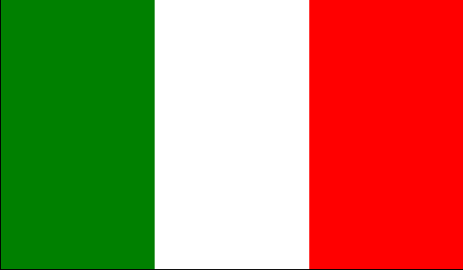
People in Studyland speak the following languages:
Slovak
French
English
Spanish
and a little Italian
Notes:
Vložte obrázok zvieraťa alebo rastliny, ktorú možno nájsť v danej krajine.

Slide 6

The people who live on islands called Studyland are cheerful, they like to laugh and love folklore
Notes:
Na časovú os pridajte kľúčové body z histórie danej krajiny.

Slide 7

Interesting facts:
Everyone must know at least two languages
All of children must go to school
Everuone should like folk
Notes:
Sem vložte obrázok na ilustráciu zvyku alebo tradície.

Slide 8
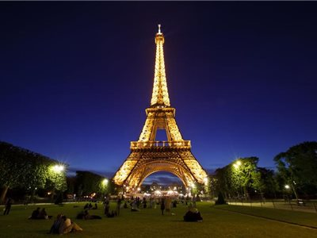
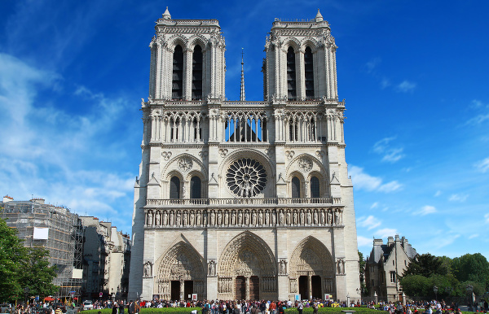
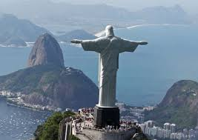
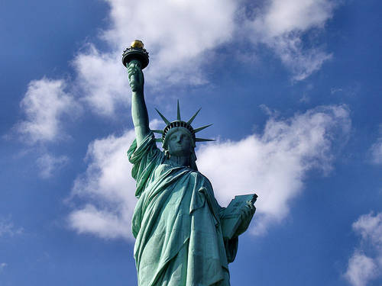
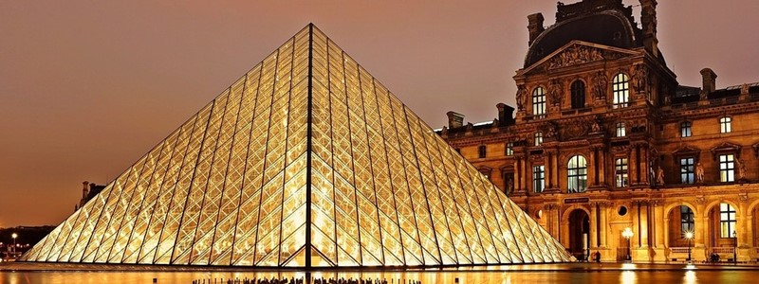
The most famous landmarks of Studyland
Eiffel Tower in Paris
Notre Dame Cathedral in Paris
Louvre Museum in Paris
Statue of Christ the Redeemer in Rio de Janeiro
Statue of Liberty in New York
Notes:
Vložte obrázok hlavného predstaviteľa danej krajiny.

Slide 9

Thanks for paying attention!!

